Slide 1
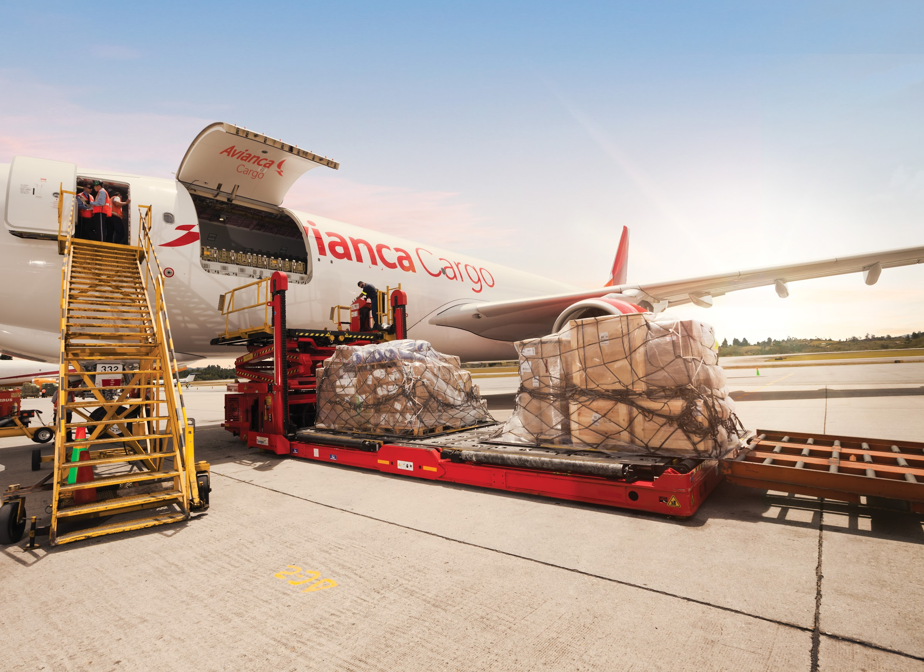

Aircraft Optimization — Cargo Mix
Cargo Pioneers

Slide 2
Table of Content
Research Question
How to use the weight and volume data of items to optimize aircraft space allocation and inventory management?
Business Understanding
Insights into industry competitors and status
Project Understanding
Project evaluation and description
EDA and Data Treatment
Preprocess the data and then analyze it through visualization
Modeling Approach
Describe the model and specific methods that will be used
Progress Description & Demo
Presented a schedule of deliverables and standards for deliverables
Development & Recommendations
Indicated current limitations and real-life recommendations

Slide 3
Executive Summary
This project focuses on optimizing cargo loading for Avianca Cargo’s A330F aircraft to maximize the cargo weight and space utilization. The aircraft’s cargo configuration includes 20 P1 boxes and 3 P6 boxes in the upper hold, along with 4 front and 4 rear boxes in the lower hold.
The challenge is to efficiently load diverse cargo types, balancing both space and weight distribution. Using advanced algorithms like 3D bin packing and DBLF, the project aims to fully utilize available space and ensure optimal loading while maintaining safety. This will lead to improved operational efficiency and profitability for Avianca Cargo.

Slide 4
Our Team
Business Team
Xiangning Li Yibo Wang Dong Wang
Technical Team
Shumiao Xu Tianshu Wei
Business Major
Skill Sets:
NLP, Data Analysis, Business Analysis, Finance
Finance and MIS Major
Skill Sets:
Data Analysis, Predictive Modeling, Business Analysis
Commerce Major
Skill Sets:
NLP, Data Analysis, Predictive Modeling, Business Analysis
AMS Major
Skill Sets:
Data Analysis, Machine Learning, Programming and Tools,
Statistics Major
Skill Sets:
Data Analytics, Business Analytics, Machine Learning

Slide 5
Our Team
Communications Team
Tianyu Xu Tianren Wang
Analytics Team
Xin Gao Keyi Li
Math Major
CS Minor
Skill Sets:
NLP
Data Visualization
Math Major
Skill Sets:
Visualization
Valuation
Operation Analytics
Math Major
Skill Sets:
Data Visualization
NLP
Predictive Modeling
Finance Major
Econ & BA minor
Skill Sets:
Data Mining
Feature Engineering
Database MGMT

Slide 6
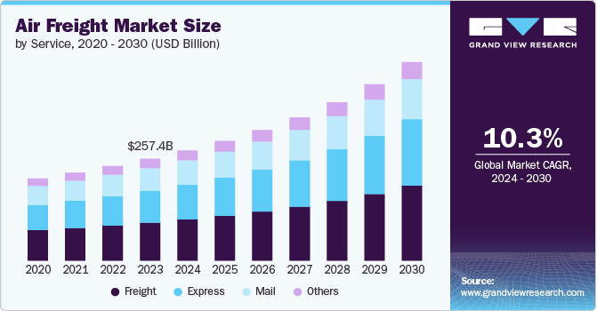
Business Understanding
Competitor Analysis
LATAM Cargo (Latin America):
Strength
Competition
Atlas Air Cargo (Global):
Supports Amazon’s expanding e-commerce operations
Enhanced its pivotal role in e-commerce logistics
Supports the burgeoning demand for e-commerce
Global freight giants:
DHL Aviation, FedEx, UPS
*** For more information, please refer to the slide deck from QSI group.

Slide 7
Business Understanding
Difficulties
Cargo demand is declining
Avianca Cargo’s cargo revenue fell by 8.3% to US$152 million in the first quarter of 2024, according to reports.
Market competition is intensifying
The trend of e-commerce from Asia to Latin America is growing ➡️ highly competitive
LATAM Group are also increasing their cargo capacity
Capacity Optimization
Balancing the cargo mix to maximize space utilization and profitability is crucial for efficient operations.
Diverse Cargo Types and Handling Requirements
Cargo varies greatly in size, shape, and fragility, requiring specialized handling techniques for each type.
Ensuring safe and efficient loading while preventing damage to diverse cargo is a challenge in maximizing both space and weight utilization.
Notes:
Cargo demand is declining: Due to the normalization of demand after the COVID-19 epidemic and the continued recovery of wide-body aircraft capacity, Avianca Cargo's cargo revenue fell by 8.3% to US$152 million in the first quarter of 2024, according to reports.
Market competition is intensifying: The trend of e-commerce from Asia to Latin America is growing, so the cargo market in Latin America is highly competitive, and other airlines such as LATAM Group are also increasing their cargo capacity, which may put some pressure on Avianca Cargo's market share.
Geopolitical uncertainty is increasing: Global trade tensions may lead to a decline in freight demand and affect airlines' business. For example, changes in Sino-US trade relations may affect the volume of cargo on trans-Pacific routes. Secondly, regional conflicts such as the Israeli-Palestinian conflict may affect route safety, forcing airlines to detour and increase operating costs and complexity. In addition, political instability in some Latin American countries may lead to uncertainty in economic policies, which in turn affects trade and freight demand.
Capacity Optimization: Balancing the cargo mix to maximize space utilization and profitability is crucial for efficient operations.

Slide 8
Project Understanding
Project Objective: Optimize Avianca Cargo’s cargo mix to maximize loading efficiency while adhering to space and weight limitations of aircraft.
Core Challenges:
Balancing cargo volume, weight, and priority, alongside special handling requirements.
Ensuring operational efficiency and compliance with international air transport regulations.
Key Functional Areas:
Descriptive and Prescriptive Analysis
Spatial Accommodation Optimization
Tools: Python, Excel, Flask (Python)
Analysis Methods: Greedy Algorithms, Spatial Analytics

Slide 9
Data Overview and Proposed Treatment
Consolidado_dims_mia
21 variables, 322894 observations
Dimension details (weight, volume, length, width, height) for items with packing method
Add a new feature to filter out A330F aircrafts
OB Report - AWB
29 variables, 79,303 observations
The 643 missing values ​​in the ProductCode column are replaced with "NA".
The 51 missing values ​​in the Volume (m3) column and the 51 missing values ​​in the KG Volumetric column are removed from the DataFrame.
Combine the year, month, and day, into a new Flight_date column.
Removing redundant columns, such as year, day, week, Leg Origin, etc.
Operating Flight Number and Airway Bill Number columns are converted to strings, and Product Code, Route Owner columns, etc are converted to categorical data types.
Notes:
wts

Slide 10
Data Overview and Proposed Treatment
List_Bookings QT4047 22OCTa
44 columns, 119 rows
Delete duplicate names for Agent Name column
Delete columns with all null values and identical values
Remove “USD” in price-related columns (Charge, Yield, Bid Price (Gross))
Remove remarks columns
Delete cancelled bookings records (Booking Status = cancelled)
Load Factor Report
The dataset consists of 4,752 rows and 49 columns.
All columns are fully populated, with no missing values.
The columns include a mix of numerical data (30), categorical data (14), and datetime data (5).
There are 464 abnormal observations, among which 463 cases had an overload issue. The remaining one case had an abnormal underload value (-44531.165, which should be 0 or a positive number).
Notes:
wts

Slide 11
Research Questions and Key Messages
What is the current transportation situation? (Descriptive)
What is the distribution of cargo types on different routes?
What is cargo transportation status at each route?
What is the potential room for improvement?
How can we maximize the cargo weight utilization for the A330F aircraft under space and safety constraints? (Diagnostic):
Why can't the cargo reach its maximum load?
Why did the insufficiency of utilization happen? (Time Series and Flight Routes)
How to solve the issue of utilization inefficiency for the A330F aircraft? (Prescriptive):
What kind of loading method maximize weight/space utilization?
How to deal with the shape of irregular container?
Notes:
wts

Slide 12
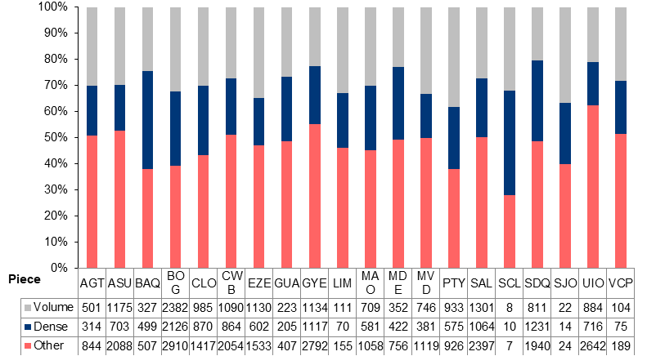
What is the distribution of cargo types on different routes?
Routes with most high-density cargo:
BAQ, BOG, SDQ etc
High density cargo routes:
Optimized weight-carrying capacity
Large volume cargo routes:
Optimized cargo space allocation

Slide 13
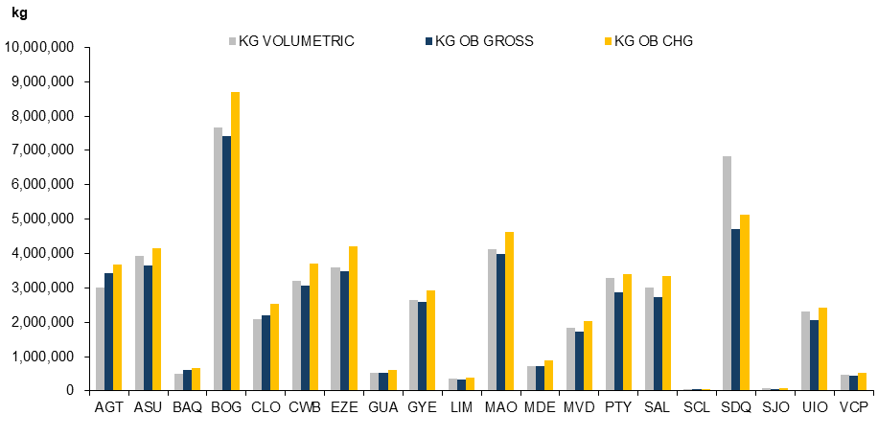
What is cargo transportation status at each route?
Mainly charged by volumetric weight:
BOG and SDQ
Mainly charged by the actual weight:
SDQ and PTY
Optimize charging strategies.

Slide 14
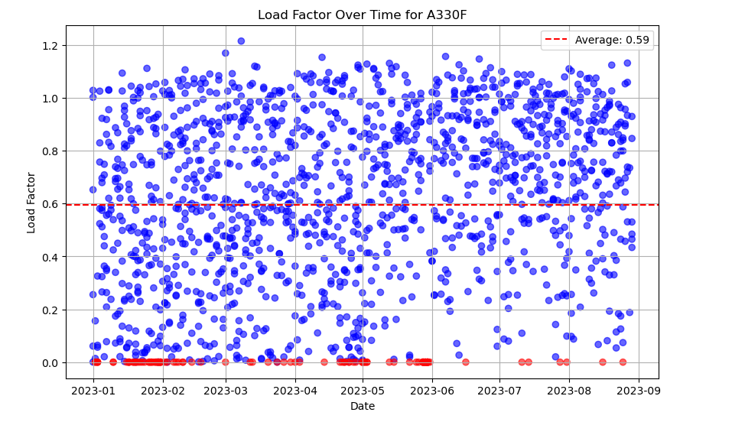
Why did the insufficiency of utilization happen?
Time Series
Extreme Insufficient Utilization
KG CHG/CAP FIS KG
Red spot is 0
Notes:
Shows the change in Load Factor for the A330F aircraft type over time. The Load Factor is the ratio of the actual load (KG CHG) to the maximum allowable load (CAP FIS Kg). With this ratio, the load efficiency and utilization of the aircraft can be evaluated.
Demonstrates the Payload Efficiency of the A330F aircraft type over a period of time. Payload Efficiency is the ratio of actual gross load to maximum allowed payload , which reflects the extent to which the aircraft's payload is utilized.

Slide 15
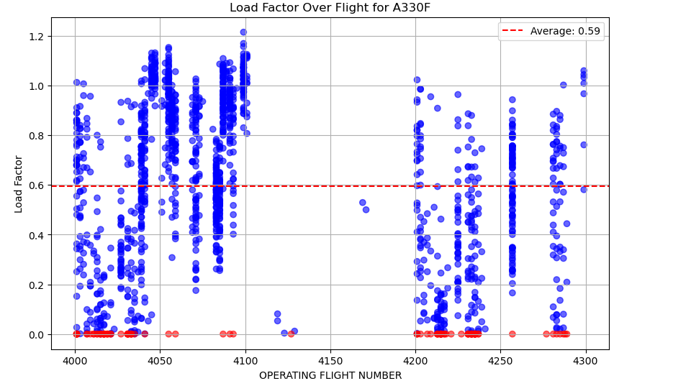
Why did the insufficiency of utilization happen?
Flight Routes Number
Extreme insufficient utilization happened for certain flight routes.
Notes:
This chart shows the load factor (Payload Efficiency) of the A330F freighter across different flight numbers. The x-axis represents the Operating Flight Number, and the y-axis shows the load factor. The blue scatter points indicate the load factor for each flight, while the red dashed line represents the average load factor (average_payload_efficiency), which is 0.59. The load factor is calculated as the ratio of the actual cargo weight to the maximum allowed payload , with data filtered to exclude values greater than 2. The chart reflects the fluctuations in load factor and overall operational efficiency across flights.

Slide 16
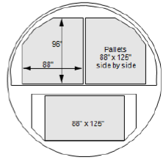
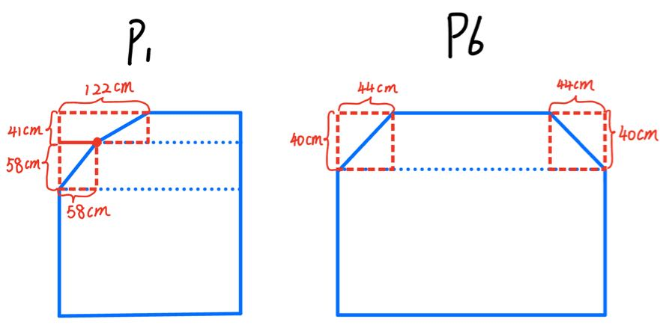
What kind of loading method maximize weight/space utilization?
How to deal with the shape of irregular container?
Greedy Algorithm
At each step, choose the best option based on current criteria without considering future decisions or the overall situation.
Load items by prioritizing those with higher weight.
Optimize weight and space utilization individually for each bellyhold to generate the optimal result as a whole.
Spatial Analytics
Spatial analytics is the process of analyzing location-based data, or geodata, to gain insights and knowledge.
Add red boxes to ensure space will not be occupied (Main Deck)
Use cube as container for lower deck per sponsor’s requests
Container Modeling - Similar to Calculus

Slide 17
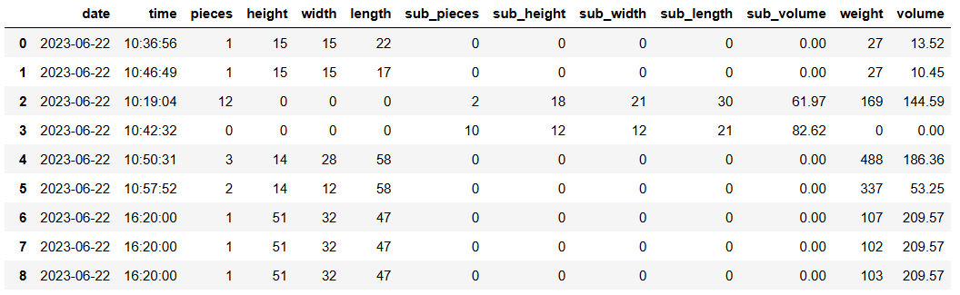
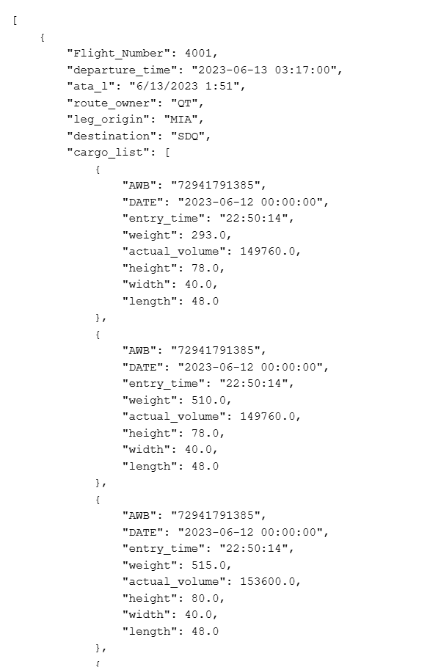
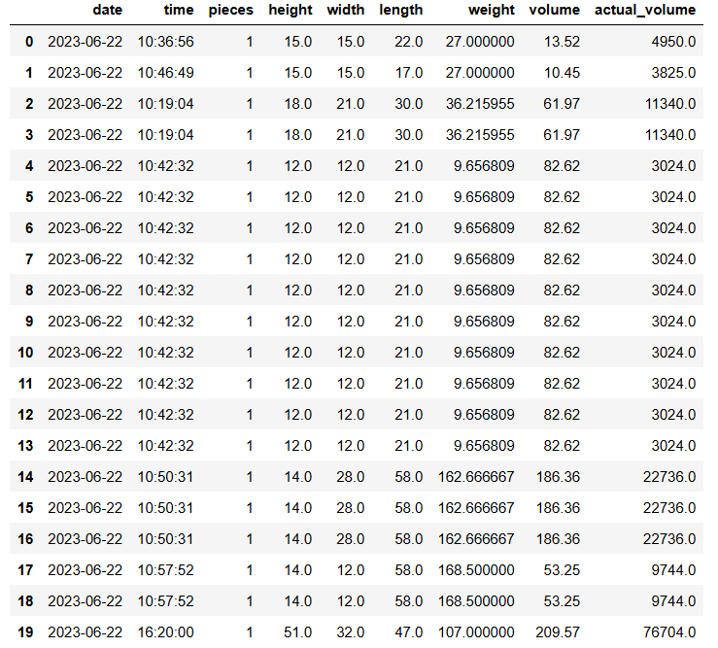
Solution Section I
Data Pipeline
Load the dataset.
Complete data cleansing and processing (duplicate rows which contain more than 1 piece of package, sub_demensions replacement,missing value and etc).
Develop a Data Transformation Pipeline to perform dimensional and weight adjustments, calculate necessary metrics, and prepare the processed data for direct integration into the Flask UI in JSON format.

Slide 18
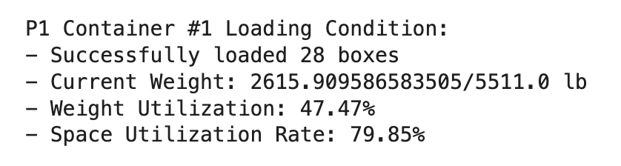
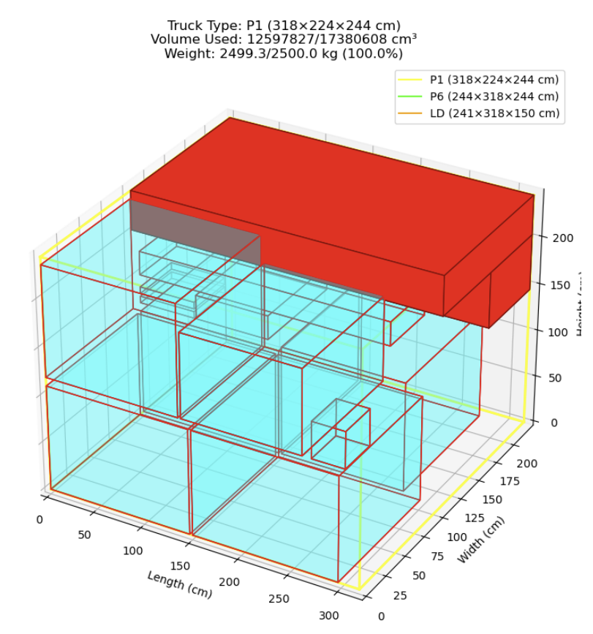
Solution Section II
Spatial Optimization
Ensured input values ​​are valid and skipped invalid data to make the code more efficient
Sort boxes with weight in descending order
Place box with higher weight at the bottom of container
Set max weight for each container.
Stop until all containers are filled up
Return remaining boxes to the pool
Formulated 3D visualization and exported detailed output to improve user experience

Slide 19
Solution Section III
User Interface
Building the Flask Framework.
Completed file uploading in the front-end.
Provide a button to trigger the /run_algorithm route, which will read the uploaded file and run the packaging algorithm.
An interaction page is formed that eventually provides a 3D graphical display for visualizing the packing of cargo and boxes.

Slide 20
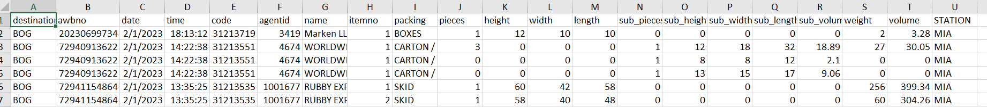
Clarification for Inputs and Outputs
Input (for flask)
A CSV file containing items awaiting to be loaded (Exact format as provided in the sample data)
Output
Display Items with awb no. in Each Container
Display Chargeable Weight and Relative Metrics of Each Container
Success Criteria: weight utilization rate & space utilization rate
Data Visual (Lower Deck + Main Deck)

Slide 21
Quick Demo
Scenario: MIA-SDQ from 1.1-1.6

Slide 22
Development & Recommendation
Data Quality
Improve data integrity, accuracy, and missing value processing.
Genetic Algorithm
Genetic algorithms can be used and better optimization can be achieved (once ensuring sufficient computing power).
Cloud Deployment
Cost Estimation by Cloud Platform.
Scalability
Real world testing and adaptation for industry use.

Slide 23
Conclusion
Optimized Avianca Cargo’s A330F aircraft to maximize cargo weight and space utilization using advanced algorithms (3D bin packing, DBLF).
Addressed challenges of diverse cargo types and safety requirements to achieve efficient loading.
Implemented spatial analytics and developed a user-friendly interface for improved operational efficiency.
Moving forward, the focus will be on:
Leveraging cloud platforms for scalability and adaptability in a competitive market.
Utilizing genetic algorithms for better optimization.
Refining data quality and handling to ensure improved cargo management.

Slide 24
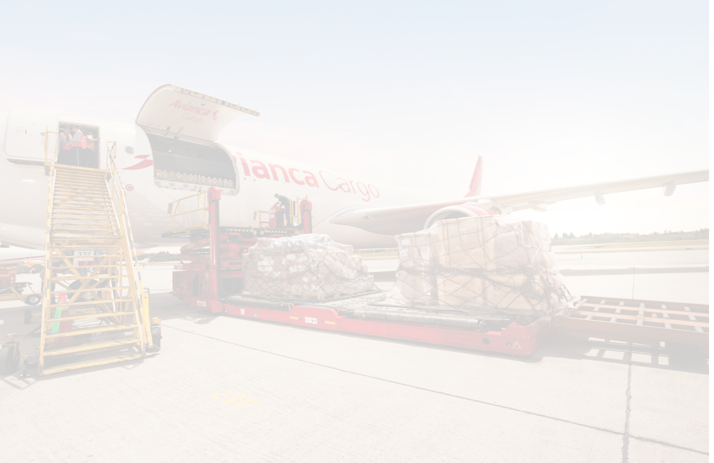
Q & A

Slide 25
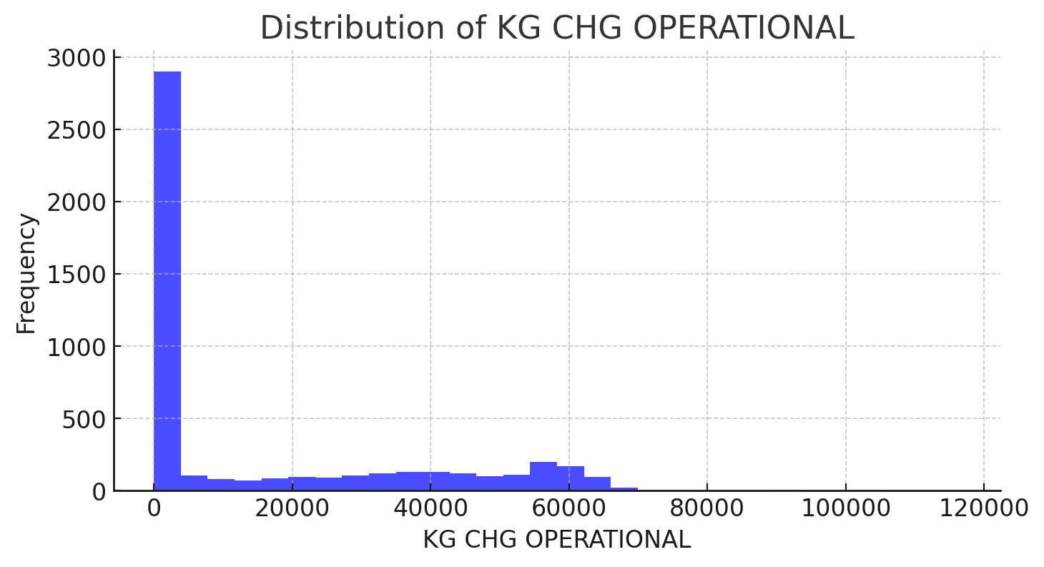
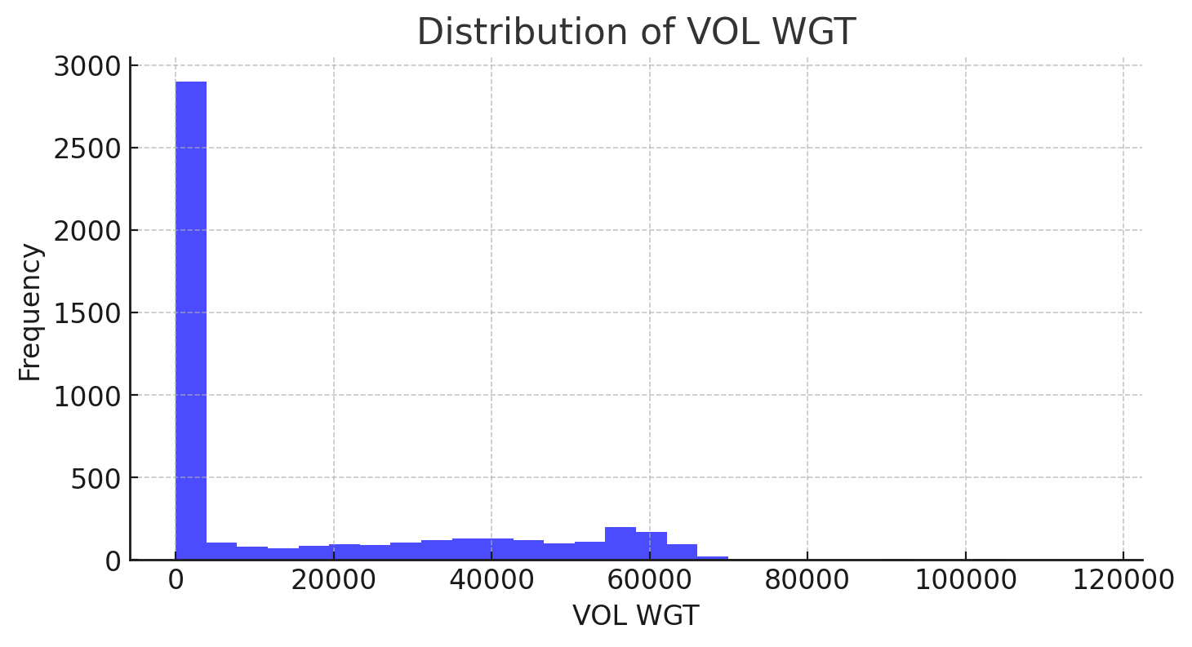
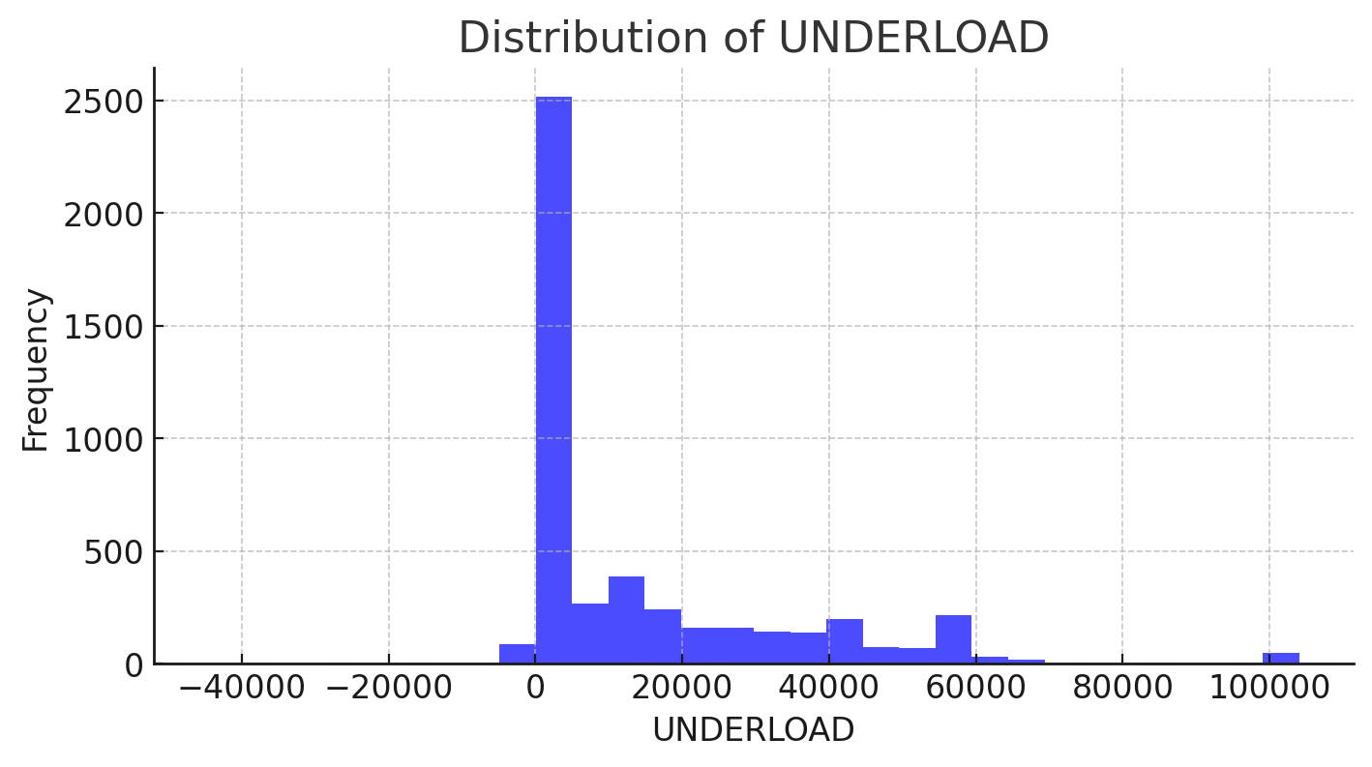
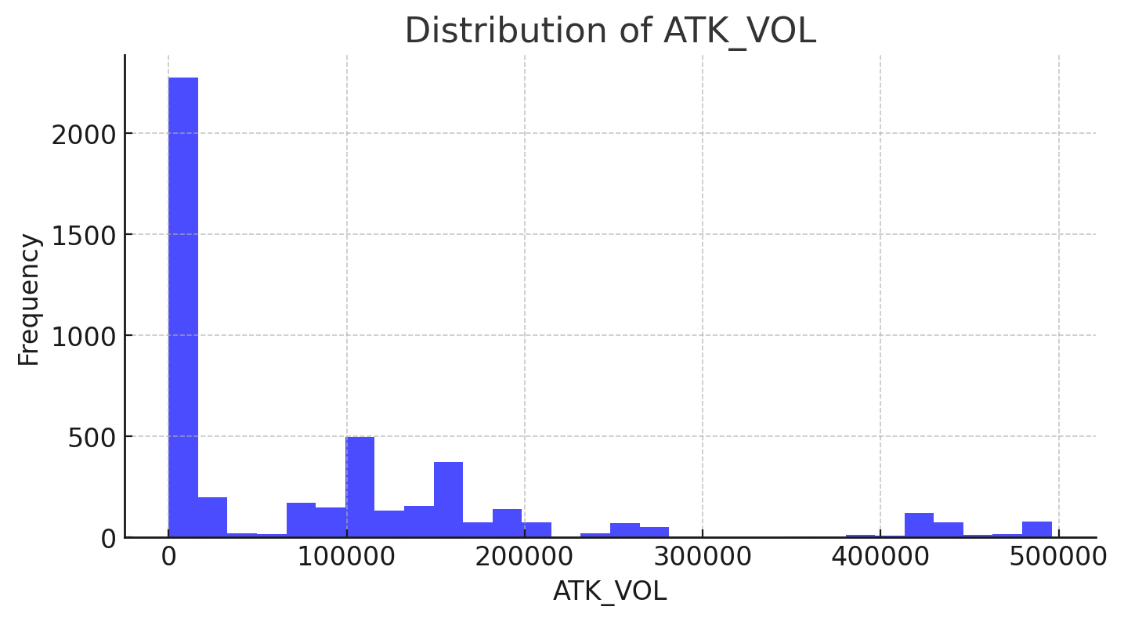
EDA other findings
Appendix A

Slide 26
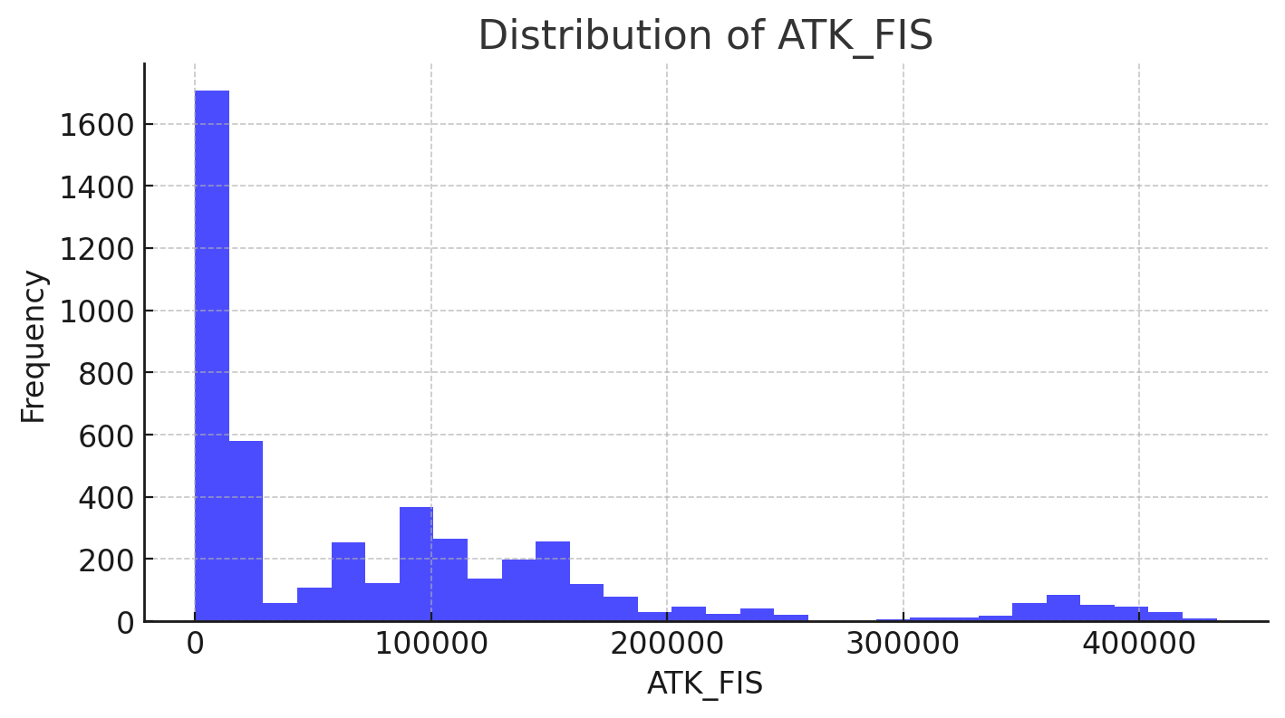
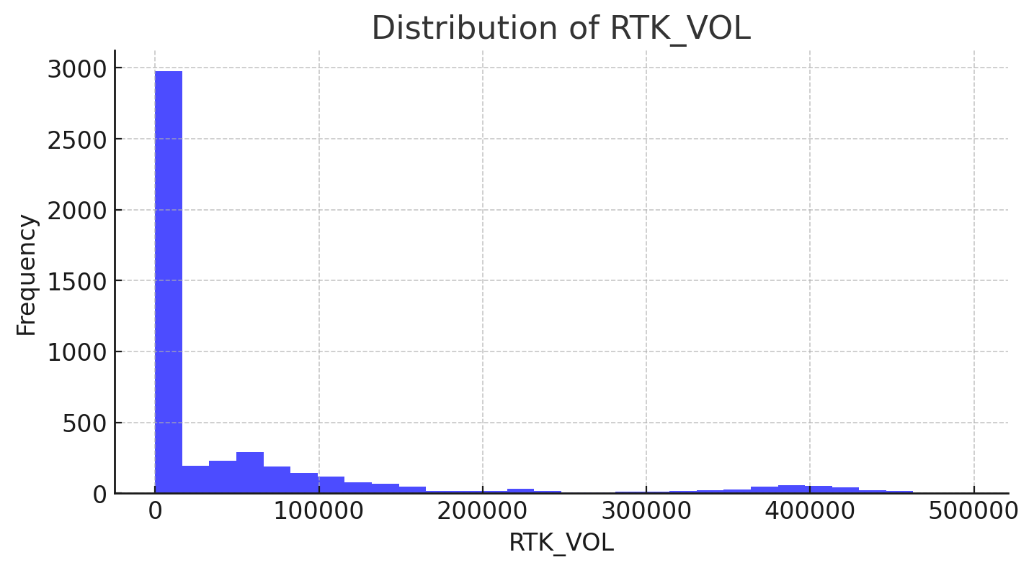
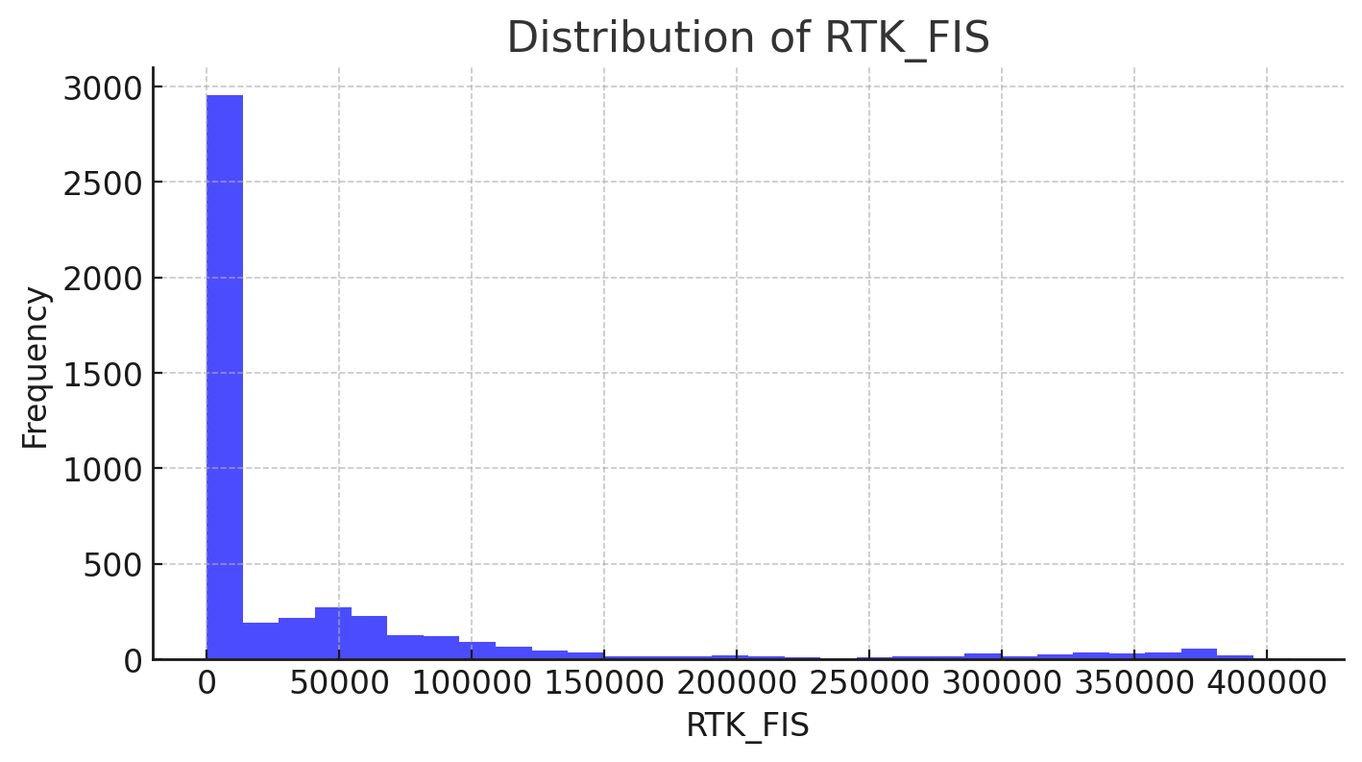
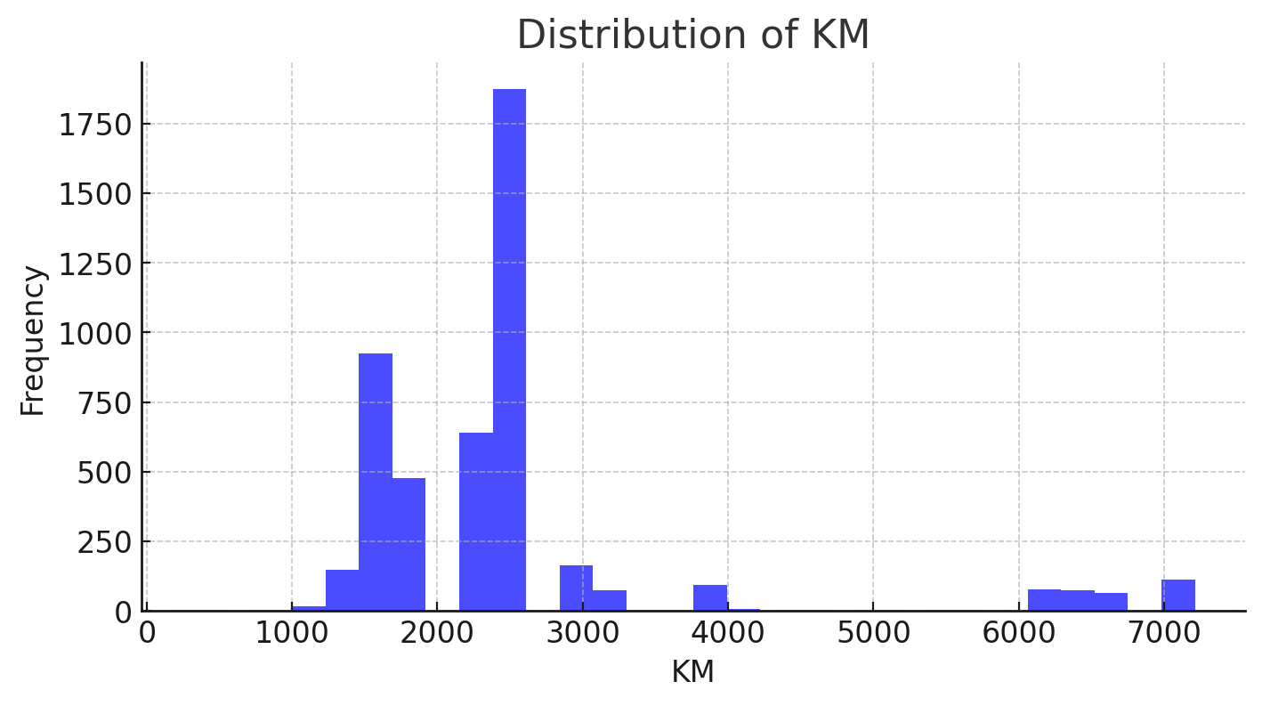
EDA other findings
Appendix B

Slide 27
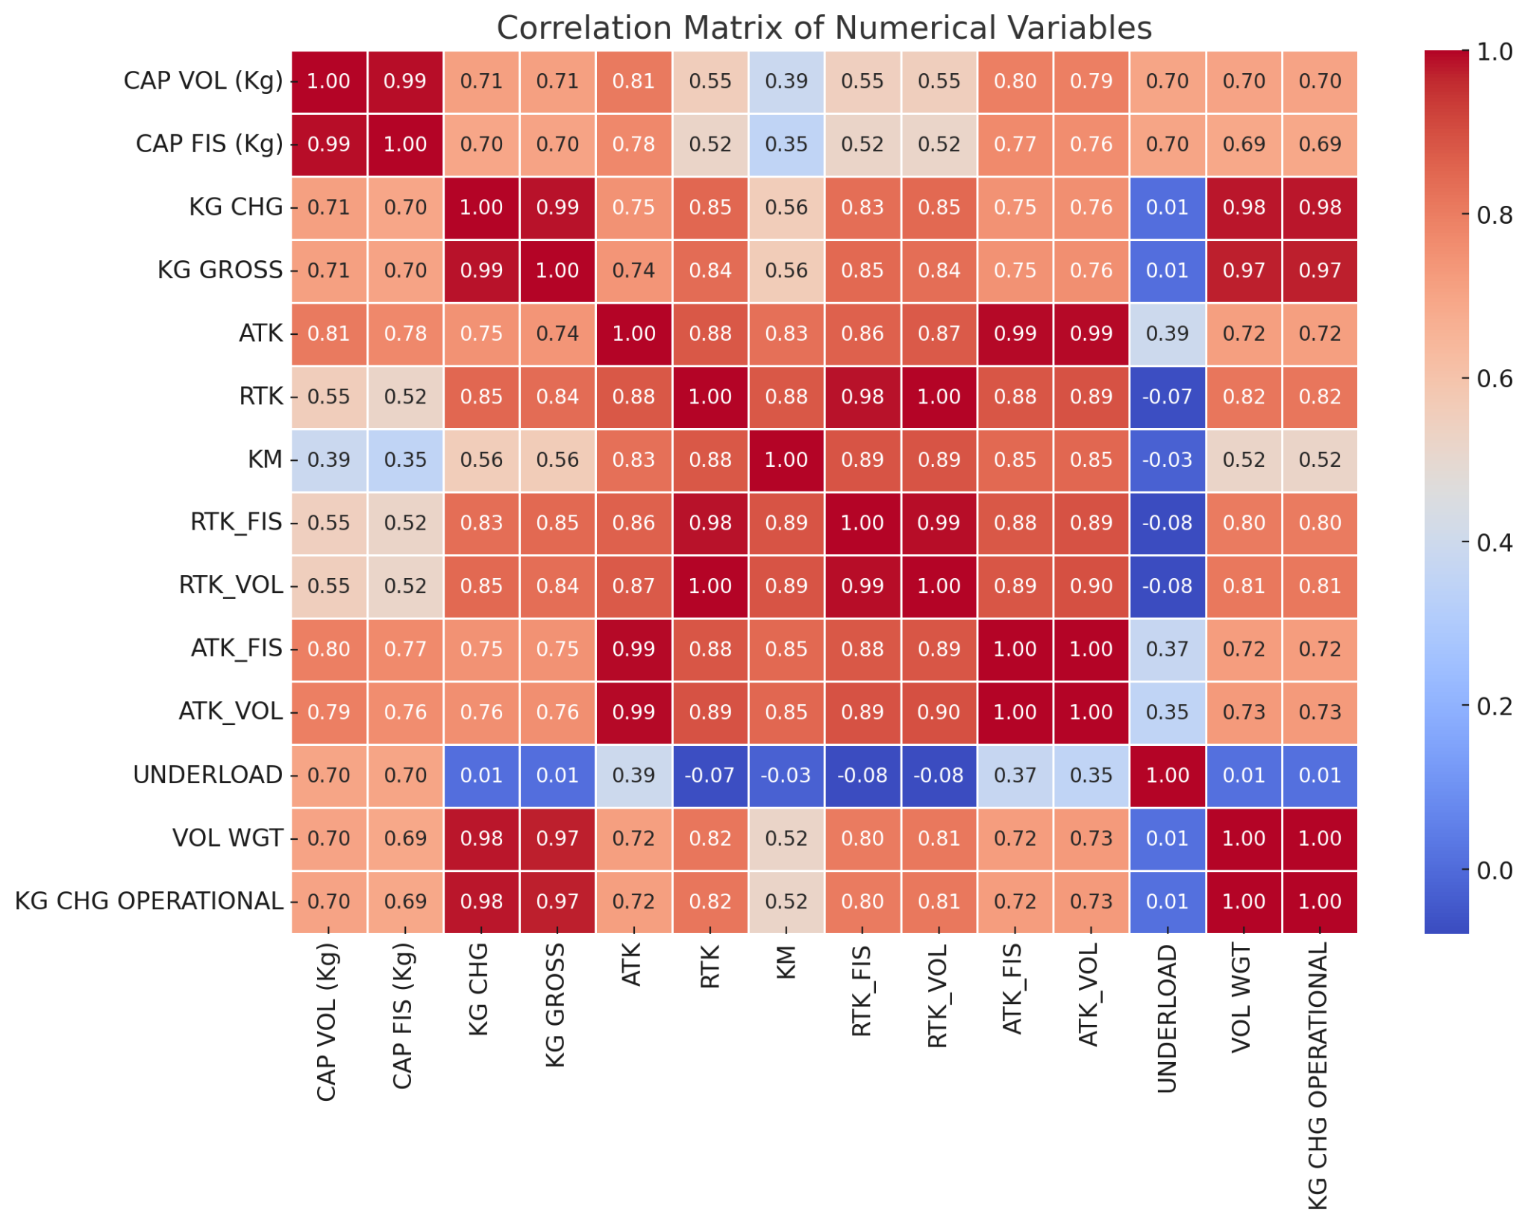
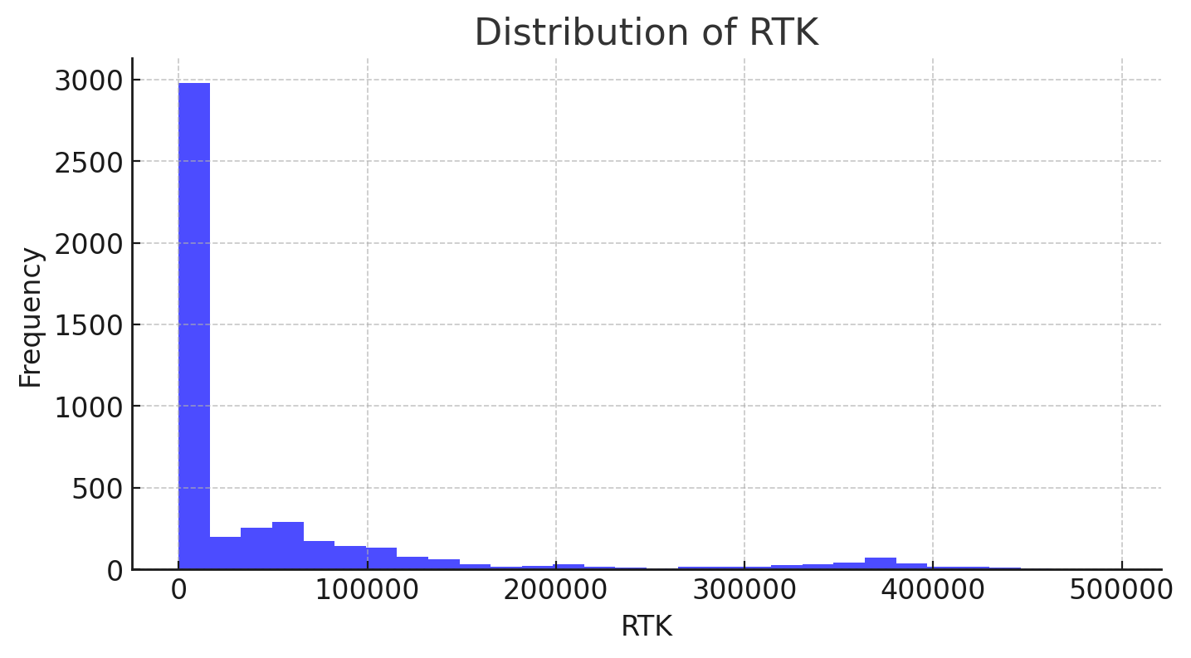
EDA other findings
Appendix C

Slide 28
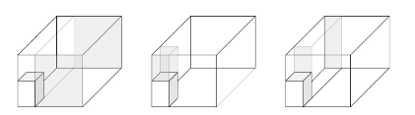
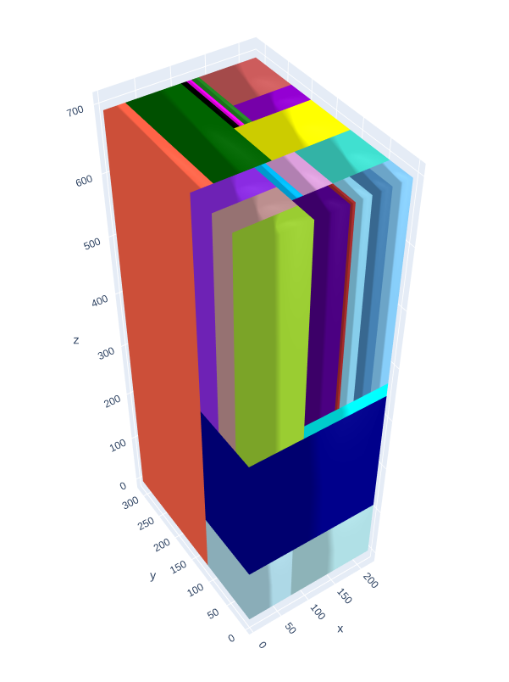
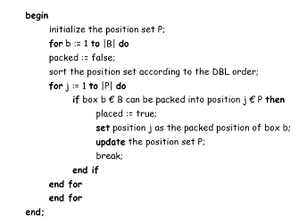
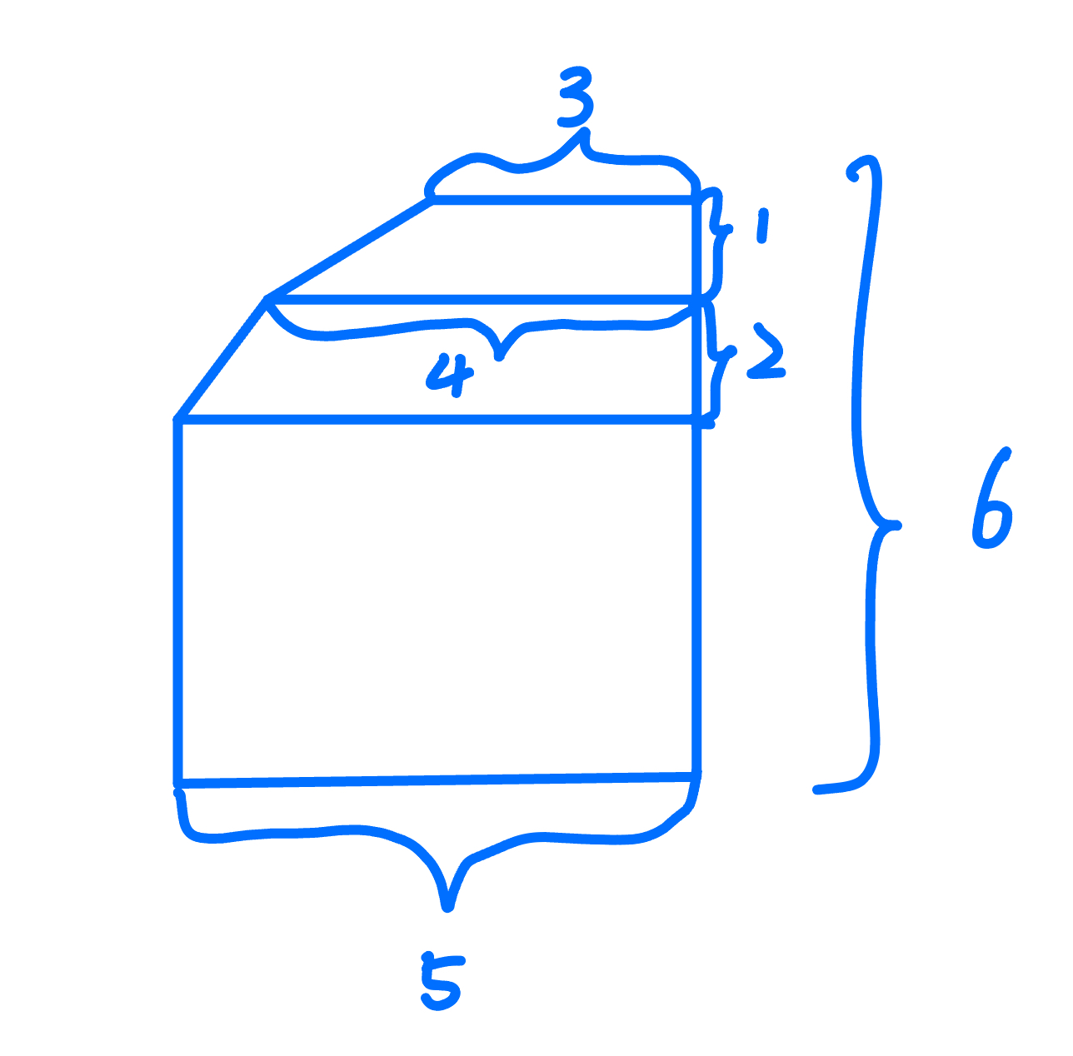
Development & Recommendation - GA
Appendix D
Algorithm Operation Diagram : Cuboid Spaces Generated after Inserting a Box
Algorithm Result
Pseudo Code for Packing
Container Modeling - Similar to Calculus
Notes:
lky

Slide 29
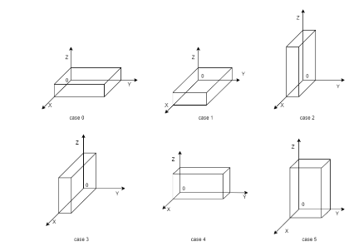
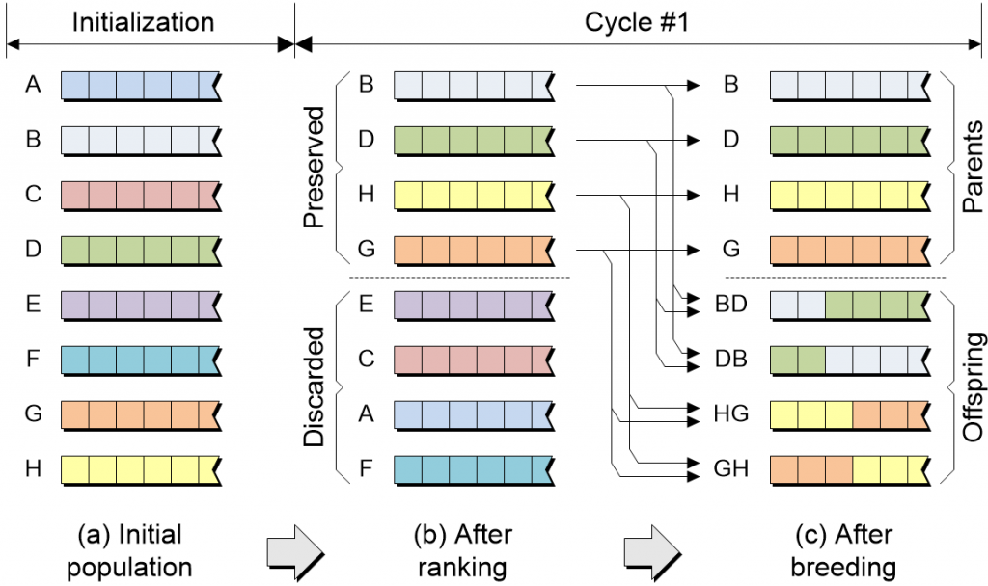
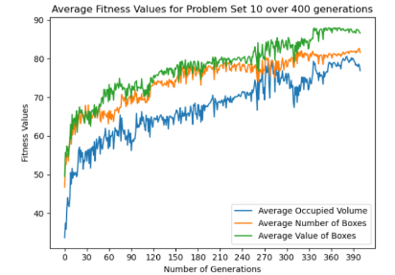
Development & Recommendation
Crossover and Mutation
Fitness Value
Appendix E
Rotation & Order
Genetic Algorithm

Slide 30
Cloud Deployment
Appendix F
Data Storage: Storing historical data and potentially new data collected during the optimization.
Compute Resources: For running optimization algorithms and machine learning models.
Data Analysis and Processing: To analyze and visualize shipment patterns, possibly using cloud-based notebooks or data warehouses.
Development and Testing: Cloud-based environments for developing and testing optimization algorithms.
Deployment: Hosting the optimization logic and any application interfaces.

Slide 31
Cloud Deployment -Cost Estimation by Cloud Platform
Appendix G
AWS (Amazon Web Services)
Compute: Using Amazon EC2 or AWS Lambda for compute resources. Costs depend on the instance type and usage duration.
Example: An m5.large instance (2 vCPUs, 8 GB RAM) for compute-intensive tasks costs approximately $0.096 per hour.
Storage: Amazon S3 for data storage. Costs start at $0.023 per GB for the first 50 TB.
Data Processing: AWS Glue or AWS Data Pipeline for ETL jobs. Pricing is based on data volume.
Machine Learning: AWS SageMaker for model training and deployment. Costs depend on instance hours and storage.
Estimated Monthly Cost: Approximately $200–$1,000 depending on data volume and compute usage.

Slide 32
Cloud Deployment -Cost Estimation by Cloud Platform
Appendix H
Microsoft Azure
Compute: Azure Virtual Machines or Azure Functions for running computations. Example: A D2 v3 VM (2 vCPUs, 8 GB RAM) costs around $0.096 per hour.
Storage: Azure Blob Storage for data storage. Starting at $0.0184 per GB.
Data Processing: Azure Data Factory for ETL and Azure Synapse Analytics for data warehousing.
Machine Learning: Azure Machine Learning Service for training and deploying models.
Estimated Monthly Cost: Approximately $250–$1,200, depending on data and compute needs.
Google Cloud Platform (GCP)
Compute: Google Compute Engine for compute resources. An n1-standard-2 instance (2 vCPUs, 7.5 GB RAM) costs about $0.095 per hour.
Storage: Google Cloud Storage for data storage. Starting at $0.020 per GB.
Data Processing: Cloud Dataflow for stream and batch processing, priced per data volume and runtime.
Machine Learning: Vertex AI for machine learning workflows. Costs vary based on model complexity.
Estimated Monthly Cost: Approximately $220–$1,000, depending on your requirements.

Slide 33
Cloud Deployment - Recommendations for Cost Management
Appendix I
Recommendations for Cost Management
Use Spot/Preemptible Instances: These are cheaper options for running non-critical workloads.
Data Lifecycle Management: Implement automated data archiving and deletion policies to minimize storage costs.
Monitor and Optimize Usage: Use cloud-native tools to track and optimize resource consumption.

Slide 34
Satisfaction & Alignment
Appendix J
Sponsor Satisfaction and Alignment:
Key Metric: Sponsor feedback and satisfaction with the outcomes, including how well the solution aligns with their business goals and requirements.
Success: Regular check-ins and validation with the sponsor, ensuring all deliverables meet their expectations.

Slide 35
Reference
https://www.aircargonews.net/airlines/avianca-cargo-continues-digital-expansion/Links to an external site.
https://airinsight.com/avianca-posts-strong-1q24-despite-cargo-decline/Links to an external site.
https://www.freightwaves.com/news/avianca-uses-bankruptcy-exit-to-fuel-cargo-busines Links to an external site.
https://www.stattimes.com/air-cargo/air-cargo-in-latin-america-rising-amidst-rich-resources-and-real-challenges-1352899?infinitescroll=1
https://github.com/Nivedha-Ramesh/Container-Loading-Problem
https://pgs-log.com/atlas-air-muscles-up-acquisition-of-cargologica-strengthens-global-network/

Slide 36
Thank You for Watching!

